Slide 1

A Scalable Agentic AI for Multi-Modal Video Classification, Summarization, and Analysis
AAI-521 Advanced Multimodal Video Analysis
Gangadhar Singh Shiva | Nagarajan Mahalingam | Akshobhya Rao BV
Team- 3
University San Diego
December 2025

Slide 2
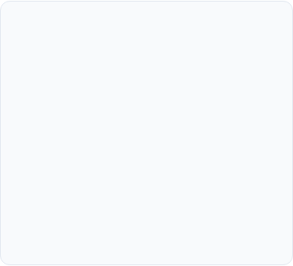
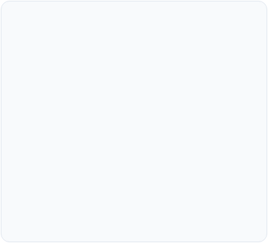
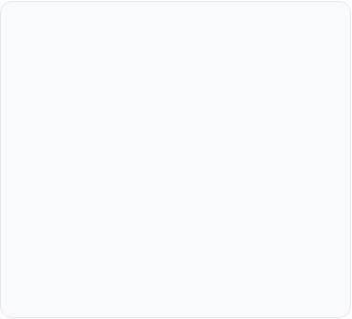



Project Objectives
Adaptive Workflow
Optimize Classification and Analysis
Multi-Modal Resilience
Design and implement a conditional processing pipeline using LangGraph to manage state and dynamically route tasks based on classification certainty.
Experiment with ResNet18, fine tuned with Lora for parameter-efficiency and CNN+LSTM+FC Layer for classification
Yolov8+SSIM - performance video analysis
Implement auxiliary data retrieval (audio transcription) and logic refinements to maintain quality and guarantee relevant contextual data.

Slide 3
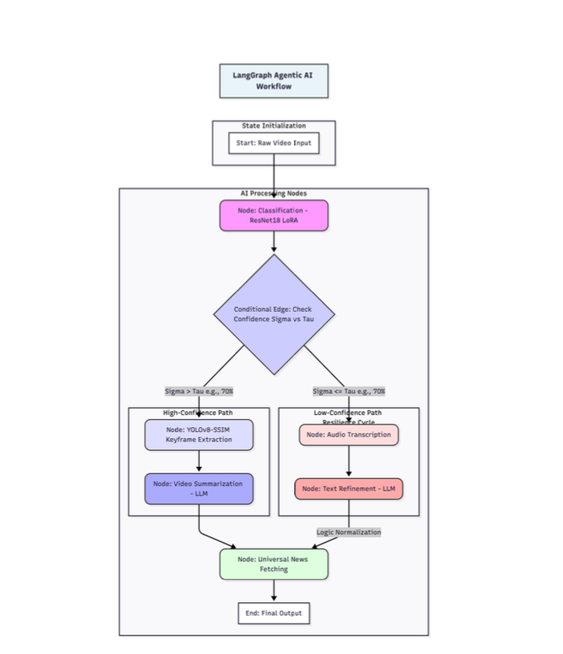
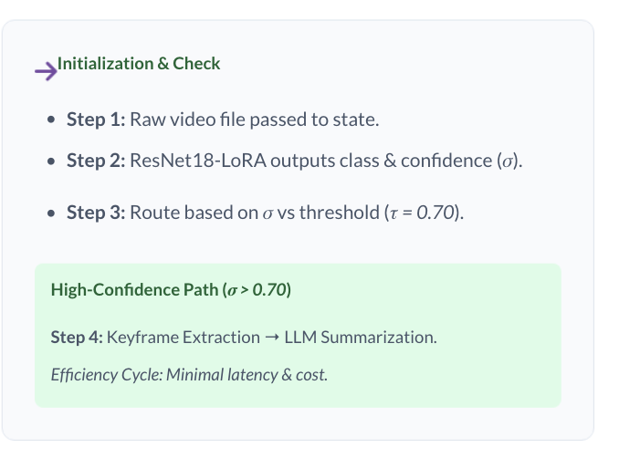
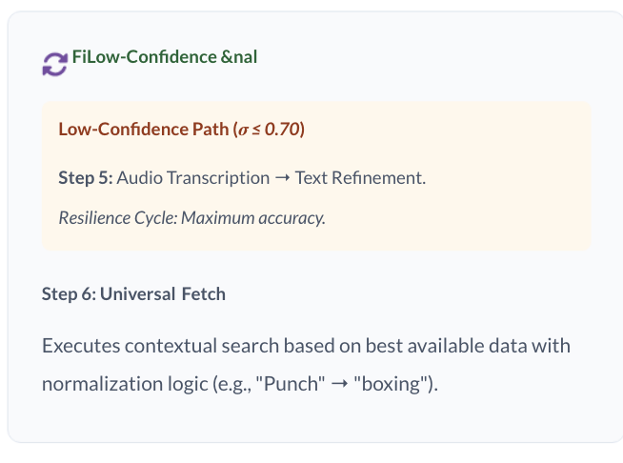
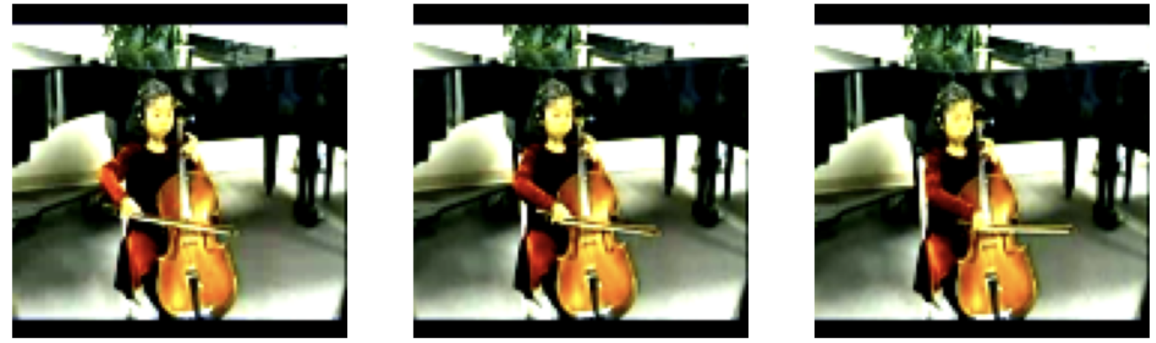
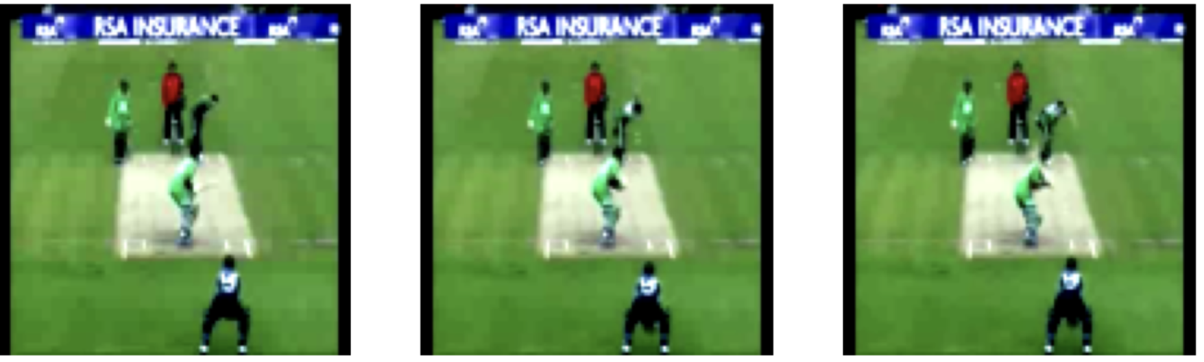
LangGraph Agentic AI Workflow - video analysis

Slide 4
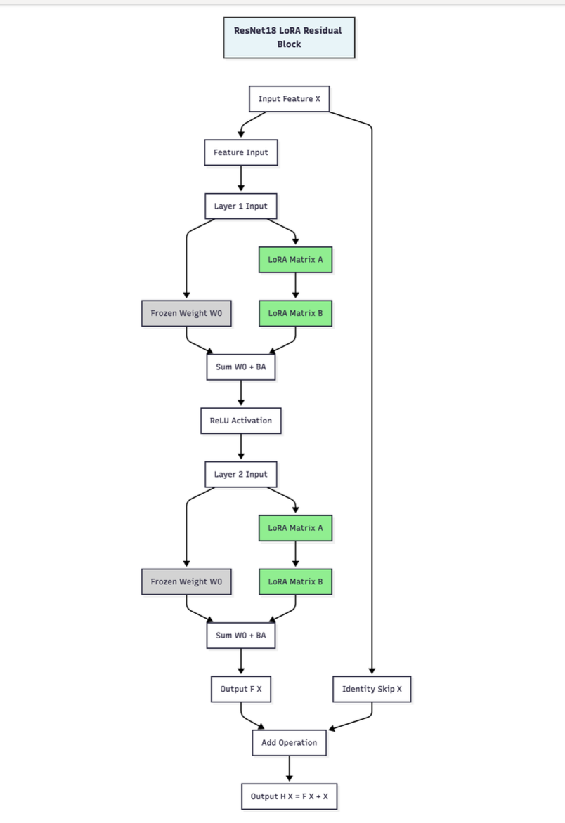
ResNet18+Lora is preferred model for Routing due to high-performance classification, reduced training costs.
Classification Architecture
ResNet18 Backbone
•
Residual connections: H(x) = F(x) + x
•
Pre-trained on ImageNet weights.
LoRA Adaptation
•
Low-rank matrices: W = W₀ + BA
•
Rank r = 4 (Only 0.5% params trainable).
Performance Metrics
Metric | Value
Validation Accuracy | 76..4%
F1 Score | 76.4%
Trainable Params | 0.5%

Slide 5
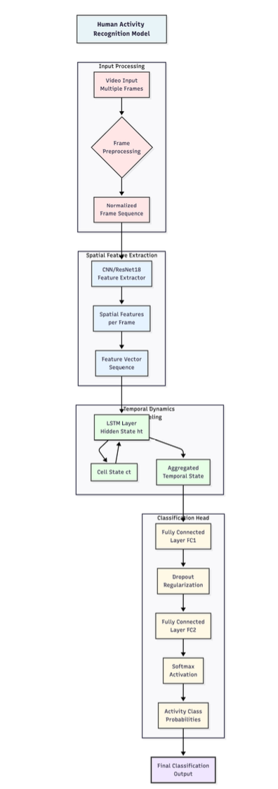
CNN-LSTM-FC Pipeline for Activity Classification
CNN -Spatial
Role: Feature Extraction
Description: Extracts robust feature vectors from each individual video frame.
LSTM -Temporal
Role: Temporal Modeling
Description: Processes the sequence of feature vectors to model dependencies over time.
FC -Classification
Role: Classification
Description: Softmax layer performs final class prediction for the entire activity sequence.
Performance Metrics
Metric | Value
Validation Accuracy | 85.4%
F1 Score | 84.1%

Slide 6

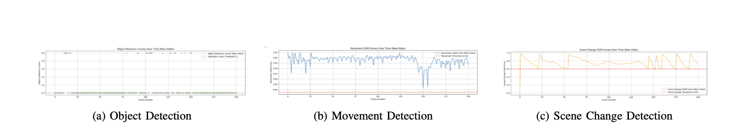
Video Analysis Pipeline
Key Components
YOLOv8n: Real-time identification of human subjects.
SSIM Analysis: Measures visual similarity between consecutive frames.
Dual-Criteria: Select if SSIM ≤ 0.85 AND human detected.
Select Frame and create a highlighted short video.
Extraction Efficiency
•
Target: ≤ 10% of total frames
•
Achieved: 8.7% keyframe rate
•
Result: 91.3% reduction in LLM tokens
YOLOv8 Real-time Identification

Slide 7

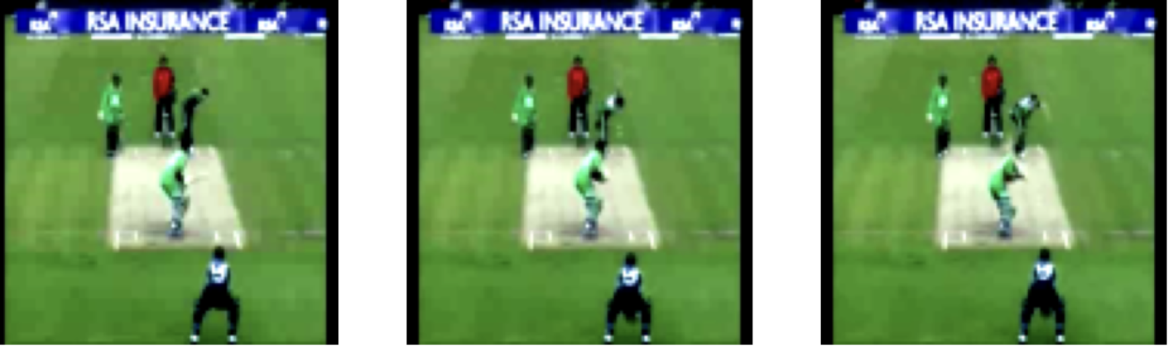
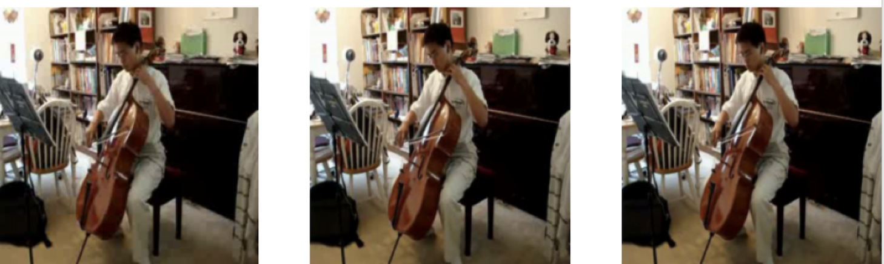
Video Summarization Results
Test Case A: Cricket
Test Case B: Running
Path: High-Confidence (Efficient)
Path: High-Confidence (Efficient)
Conf: 98.2% | Query: "cricket shot"
Conf: 99.72% | Query: "playing cello"
Action: Keyframe extraction - Successful
Action: Keyframe extraction - Successful

Slide 8

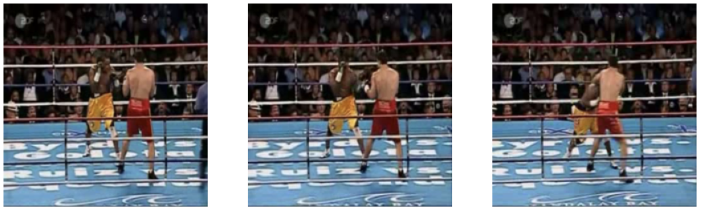

Video Summarization Results
Case D: Punch
Path: Low-Confidence (Resilient)
Conf: 55.7% | Query: "boxing"
Action: Audio Refinement (Normalized) Extraction unsuccessful
Case C: Unknown
Path: Low-Confidence (Resilient)
Conf: 42.0% | Query: "unknown"
Action: Audio Transcription - Extraction unsuccessful

Slide 9







Conclusion
The objectives of creating a robust, adaptive, and modular AI pipeline using LangGraph were successfully met, featuring parameter-efficient fine-tuning and resource-conscious summarization.
Verified Resilience
Efficiency
State-Aware
Performance
91.3% reduction in token consumption.
Reliable operational control for future AI apps.
92.4% accuracy with only 0.5% trainable params.
Multi-modal fallbacks provide comprehensive analysis.

Slide 10


